Slide 1
Chapter 6
Transferring Properties

Slide 2
Objectives
Problem Overview
Detailed Look at the Problem
Meet the Spread Operator
A Better Way to Transfer Properties

Slide 3
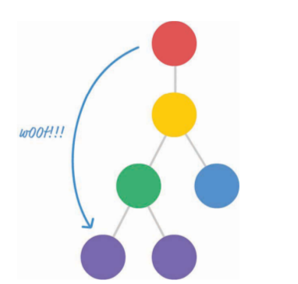
Problem Overview
React enforces a chain of command in which properties have to flow down from a parent component to an immediate child component. This means you can’t skip a layer of children when sending a property.
This also means your children can’t send a property back up to a parent.

Slide 4
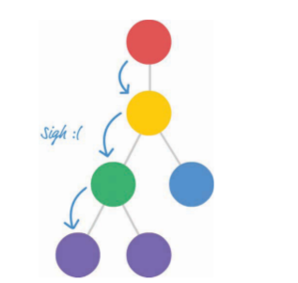
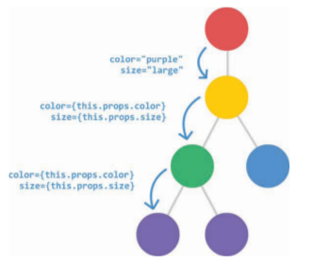
Problem Overview
Have send a property called color from the component representing our red circle to the component representing our purple circle.

Slide 5

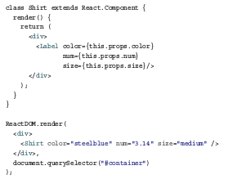
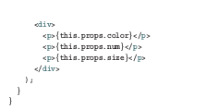
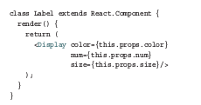
Detailed Look at the Problem

Slide 6
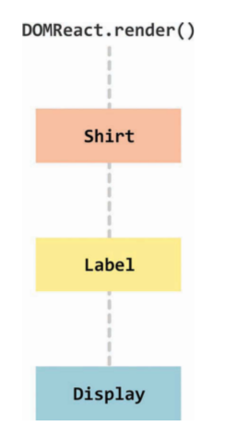
Detailed Look at the Problem
We have a Shirt component that relies on the output of the Label component, which relies on the output of the Display component.

Slide 7

Detailed Look at the Problem
When you run this code, the output is nothing special. It’s just three lines of text, as shown in

Slide 8

Meet the Spread Operator
We want to specify the three values from our items array as arguments to the printStuff function.
Here’s one really common way of doing that:
printStuff(items[0], items[1], items[2]);

Slide 9
Meet the Spread Operator
Access each array item individually and pass it in to our printStuff function. With the spread operator, we now have an easier way.
printStuff(...items);
The spread operator is the ... characters before our items array. Using ...items is identical to calling items[0] , items[1] , and items[2] individually, as we did earlier. The printStuff function will run and print the numbers 1 , 2 , and 3 to our console.
The spread operator allows you to unwrap an array into its individual elements.

Slide 10
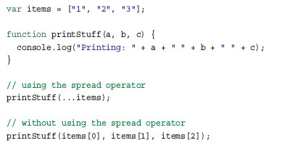
A Better Way to Transfer Properties
You just saw an example of using the spread operator to avoid having to enumerate every single item in our array as part of passing it to a function:

Slide 11

A Better Way to Transfer Properties
As part of passing these property values to a child component, we manually access each item from our props object:
As it turns out, there is a way. It actually involves the spread operator as well. We explain how later, but this means that we can call our Display component by using ...this.props :
<Display {...this.props} />

Slide 12
Conclusion
As created by the ES6/ES2015 committee, the spread operator is designed to work only on arrays and array like creatures. The fact that it works on object literals such as our props object is a result of React extending the standard. No browser currently supports using the spread object on object literals. Our example works because of Babel. Besides turning all our JSX into something our browser understands, Babel turns cutting edge and experimental features into something that’s friendly across browsers. That’s why we’re able to get away with using the spread operator on an object literal, and that’s why we’re able to elegantly solve the problem of transferring properties across multiple layers of components.

